Slide 1

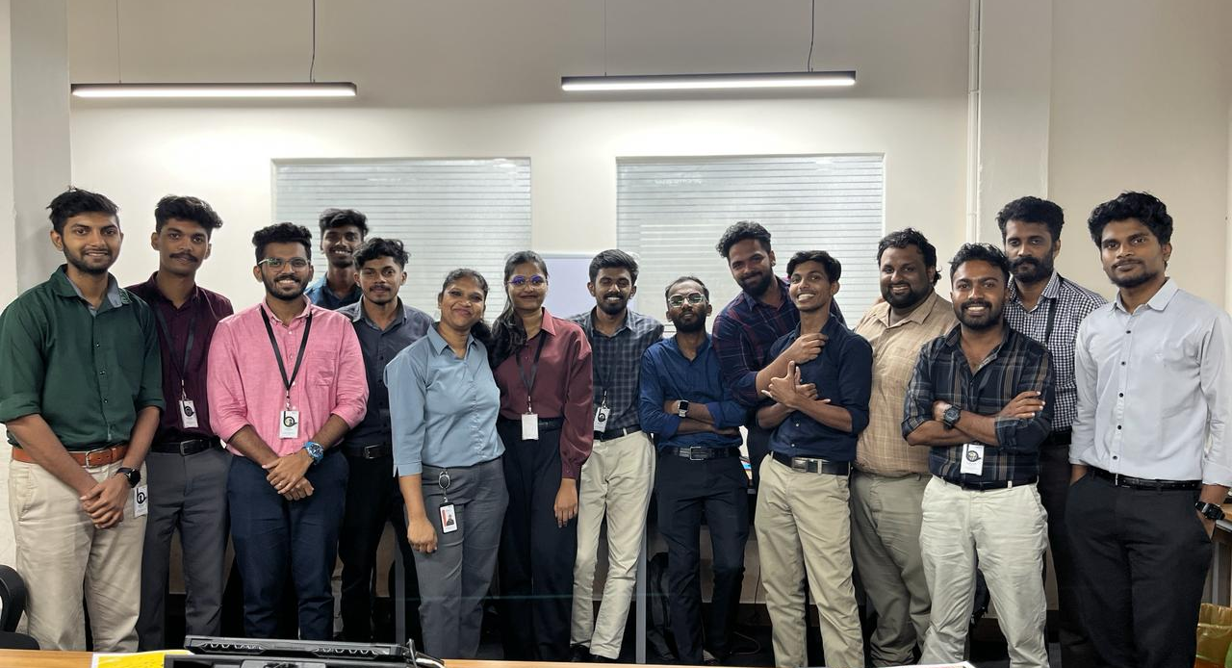
Monthly Report
BCK164
March, 2024
Abhinand Babu K
Notes:
Line spacing + Page numbers

Slide 2

01 Introduction
02 Activities
03 Teams
04 Activity of The Month
05 Highlighted Activities
06 Conclusion

Slide 3
Introduction
01
Batch BCK 164 is more than just a compilation of code enthusiasts; it represents a narrative of individual development, collective trials, and the genesis of enduring connections. We, a cohort of budding programmers, set forth on this expedition as unique entities with a myriad of backgrounds, varied experiences, and differing degrees of proficiency.

Slide 4

Activities
02
1
2
3
4
5
6
7
8
9
10
H.R discussion
Prepare Participants for Job Interview
Holiday
(Sunday)
Active Listening Game
Enhance Listening and Understanding
Feed Back
Helped to improve the Knowledge about Domain
Verbal Riddles
Challenge wit with verbal enigmas
Film Promotion,
press conference
Generate Excitement through cinematic promotion
Debate
Sharpen critical thinking through discourse
Holiday
(Sunday)
Individual Speaking
Enhance Communication skill &
Confidence
Story Telling
Transport through Narrative World shared

Slide 5
Activities
02
11
12
13
14
15
16
17
18
19
20
Holiday
(Sunday)
Individual Speaking
Enhance speaking skill & confidence
Debate
Sharpen critical thinking through discourse
Interview Speaking
Enhance Communication skill &
Confidence
Role Play
Immerse in character interaction dynamically
Filing an FIR
.
Women's Day
Celebrate Empowerment and Gender equality
World Happiness day
Spread Joy and positivity World wide
Domain Wise discussion
Improved knowledge about domain and trending technologies
Word Count Challenge
Push Boundaries within word constrains

Slide 6
Timeline
02
21
22
23
24
25
26
27
28
29
30
31
Feed Back
Helped to improve the Knowledge about Domain
Group Discussion
Exchange diverse
Perspectives Through dialogue
Debate
Sharpen critical thinking through discourse
Word Chain Story
Craft interconnected Stories seamlessly
Holiday
(Sunday)
.
My spiritual Animal
Elevating imagination, craftsmanship, and storytelling proficiency.
HR - Interview
Prepare Participants for Job Interview
HR – Discussion
Role-play
Prepare Participants for Job Interview
.
Guess the Song
Develop musical recognition abilities adeptly.
Holiday
(Sunday)
Word Pyramid
Construct linguistic structures skillfully upwards

Slide 7

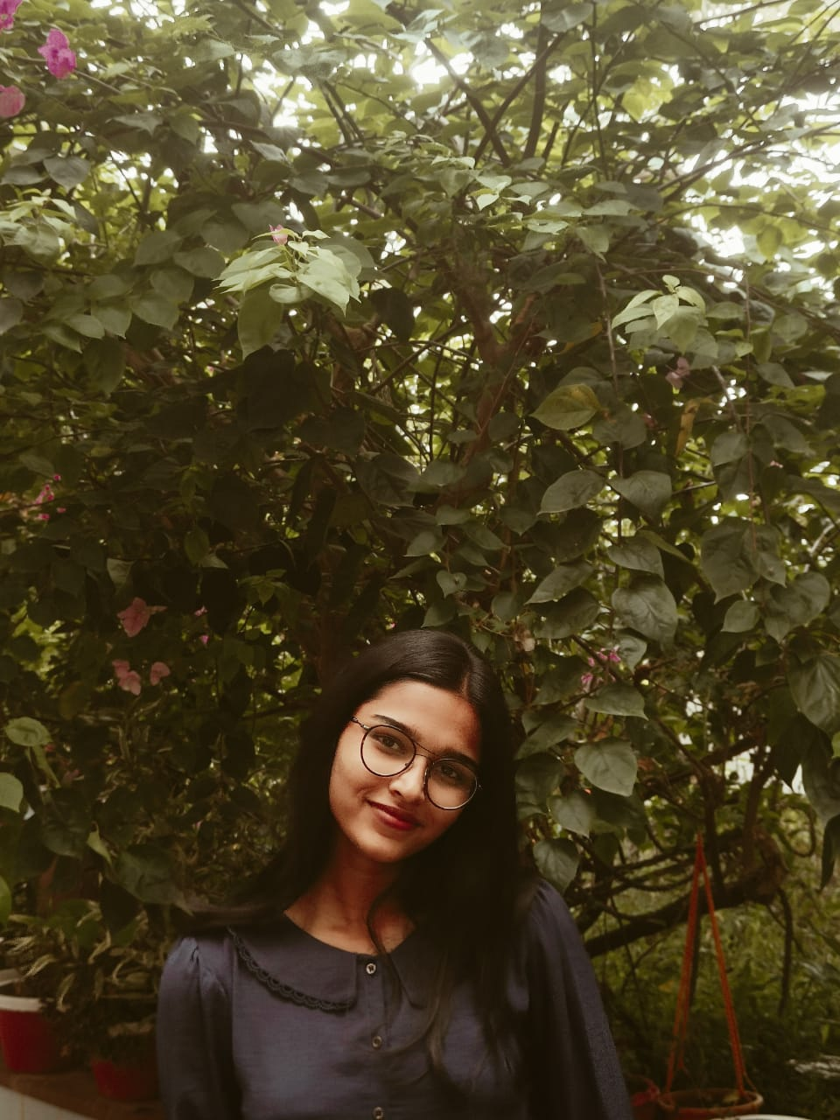
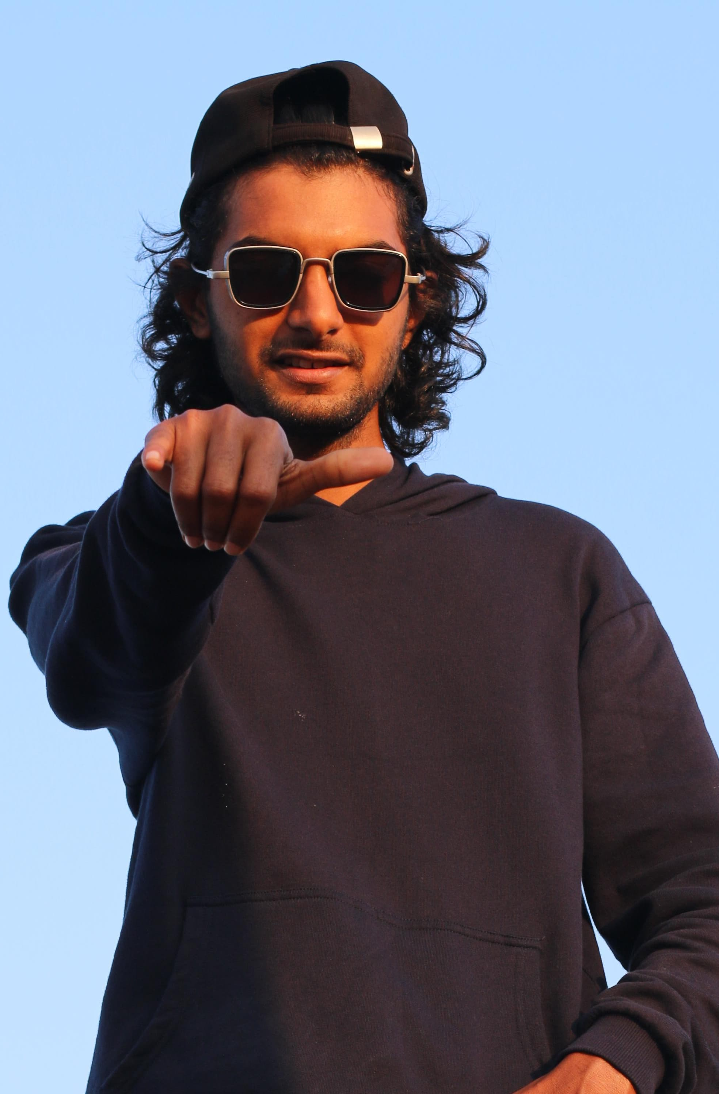
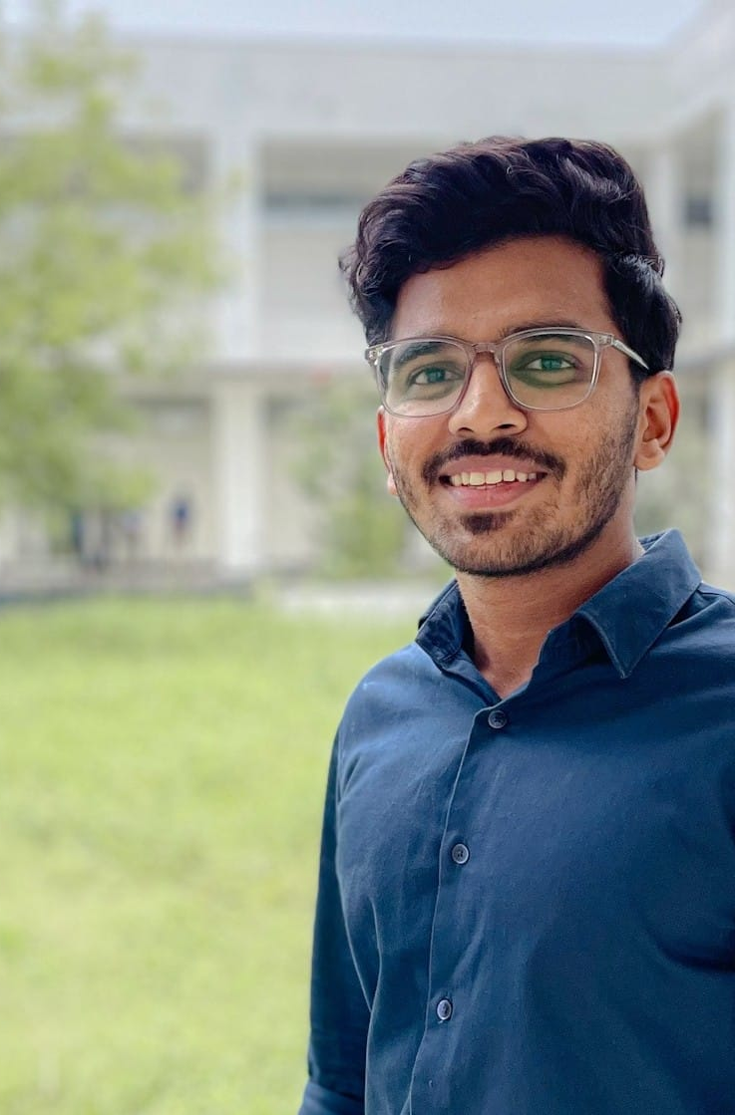
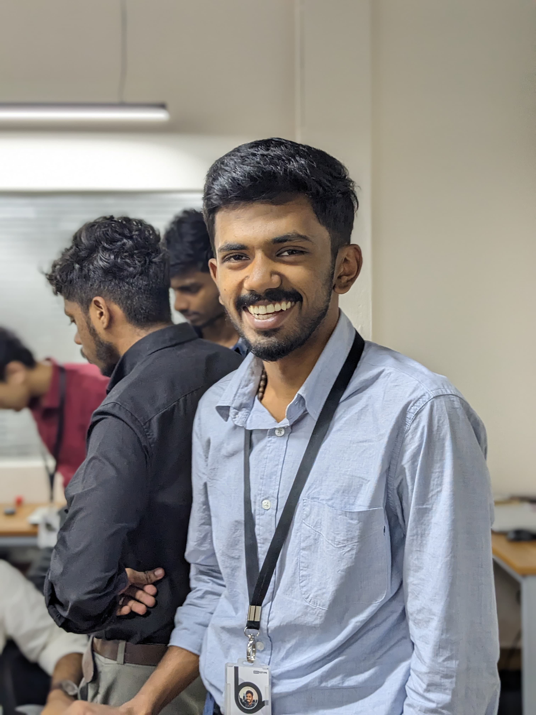
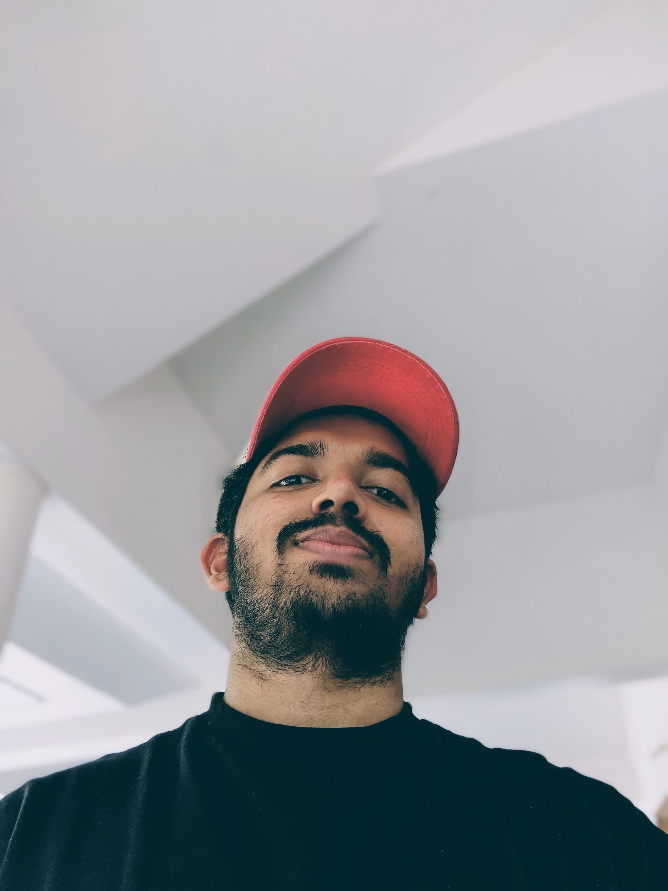
Team
03
Santhini
Level: Intermediate
Absentees: 10
Vishnu Das
Level : pre-Intermediate
Absentees: 06
Nahyan
Level : Intermediate
Absentees: 03
Ajith Glady
Level: pre-Intermediate
Absentees: 03
Thasneeh
Level: Beginner
Absentees: 03

Slide 8
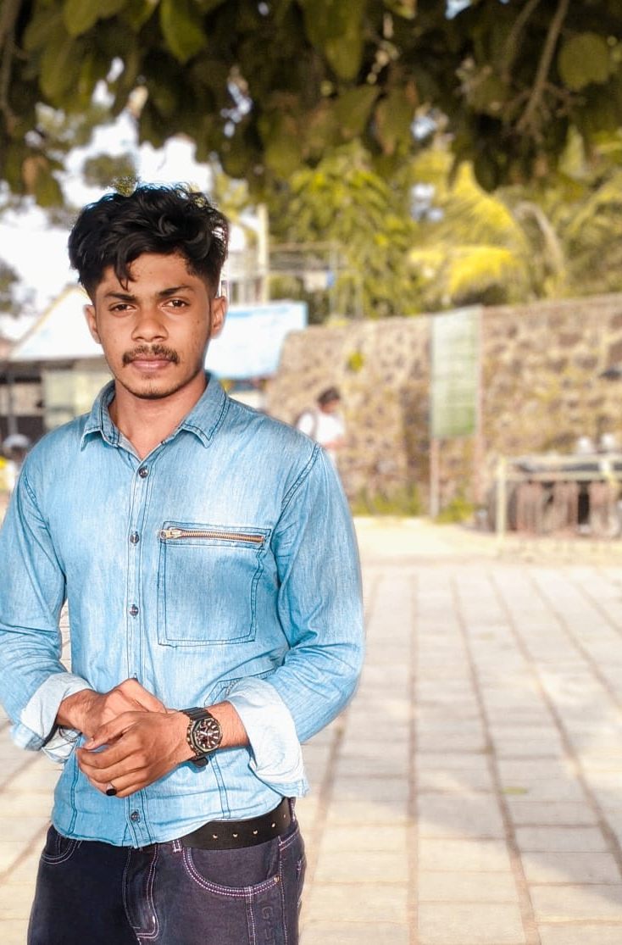
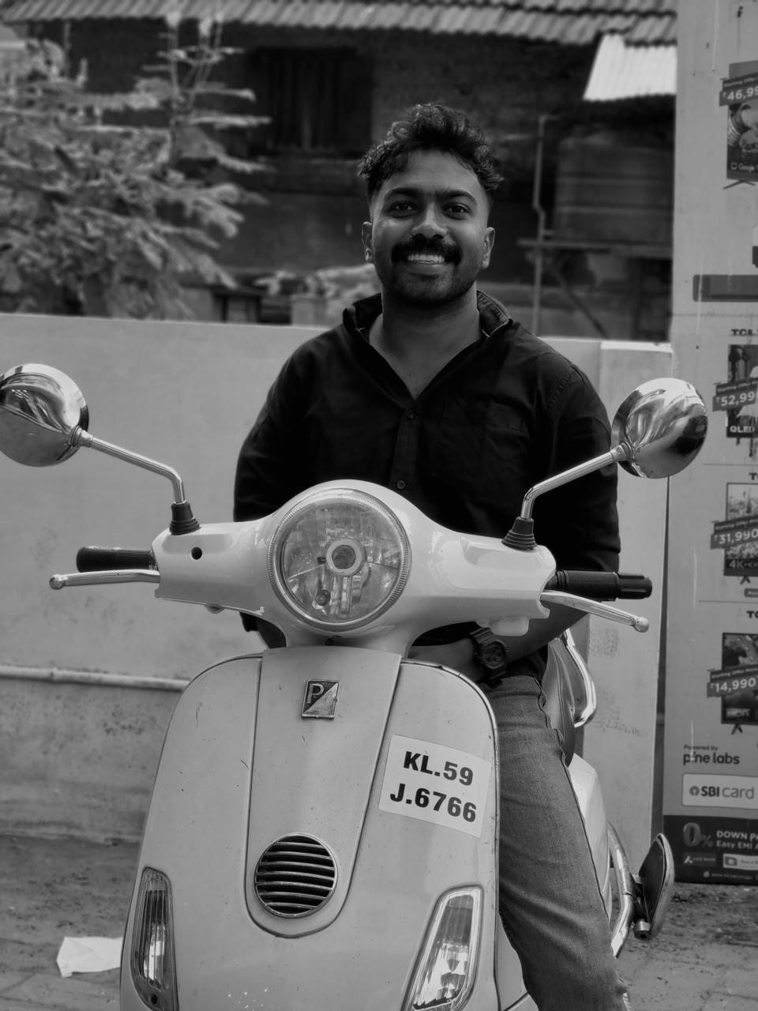
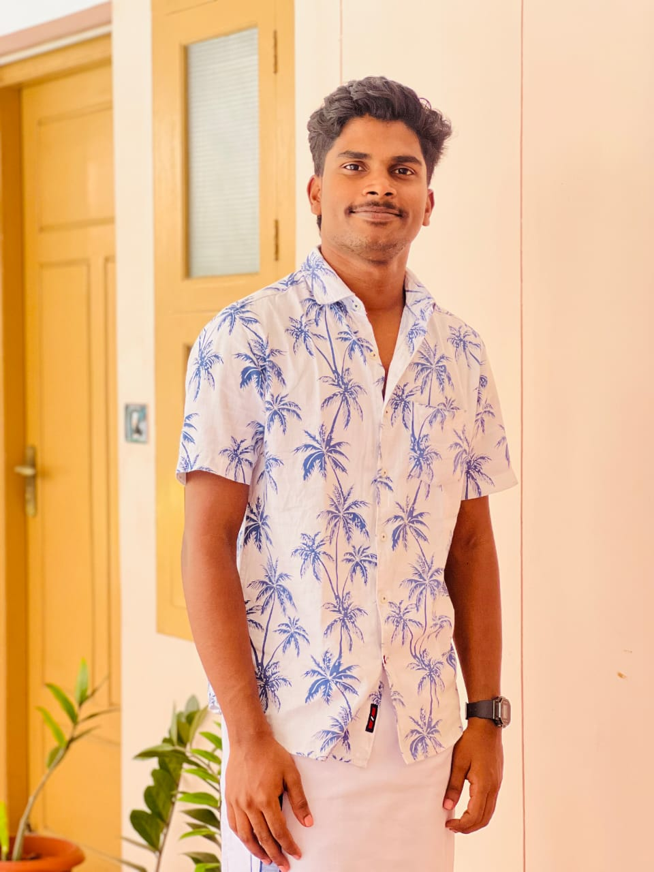
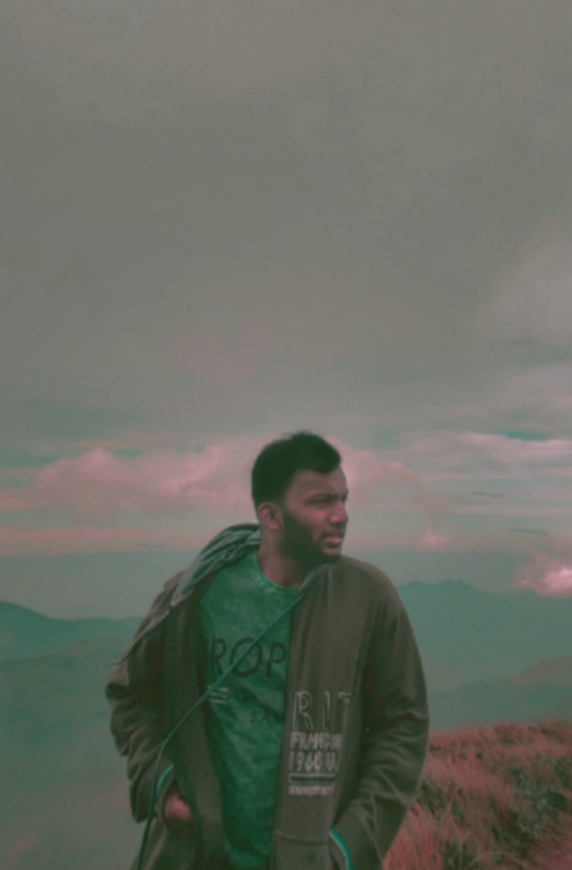
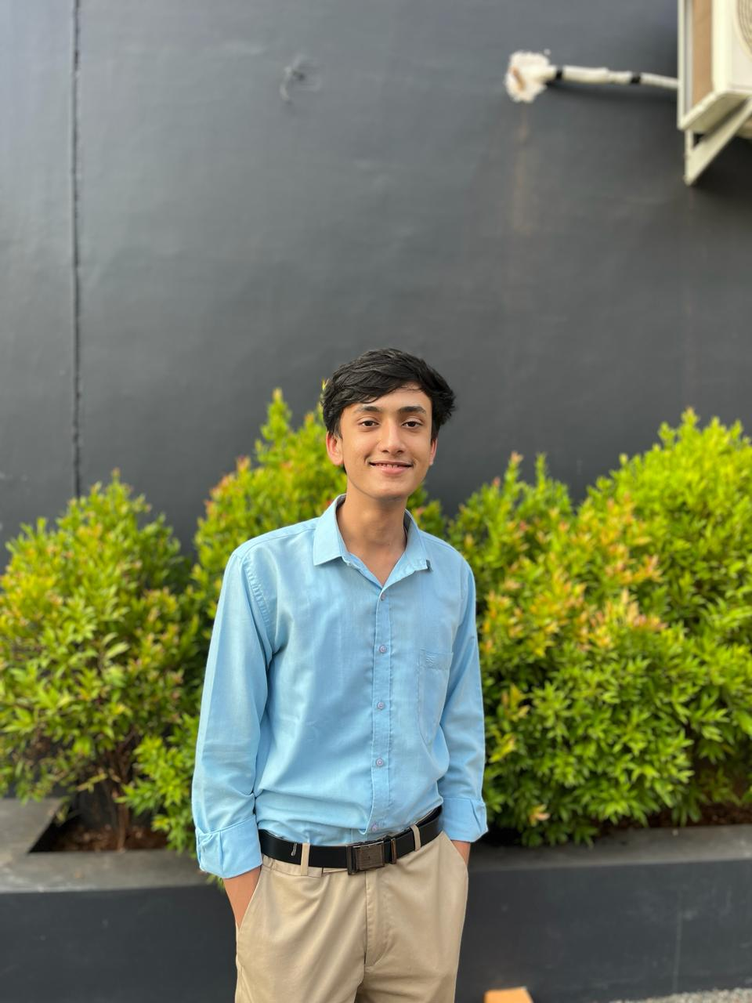
Team
03
Thakiyudheen
Level: Beginner
Absentees: 02
Shyam
Level: Beginner
Absentees: 04
Anrudhan
Level: Beginner
Absentees: 01
Abhinand
Level: Pre-intermediate
Absentees: 03
Adithyan
Level: Pre-Intermediate
Absentees: 12

Slide 9
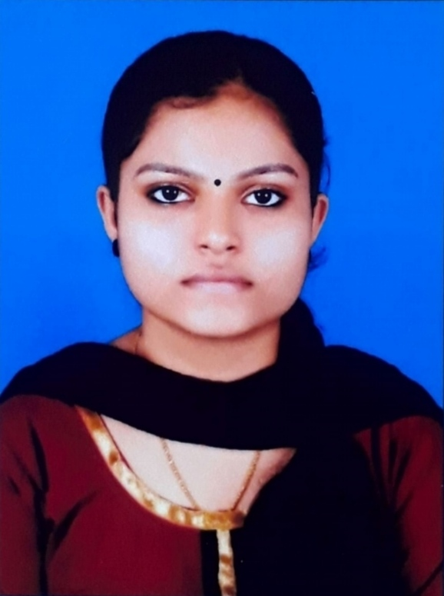
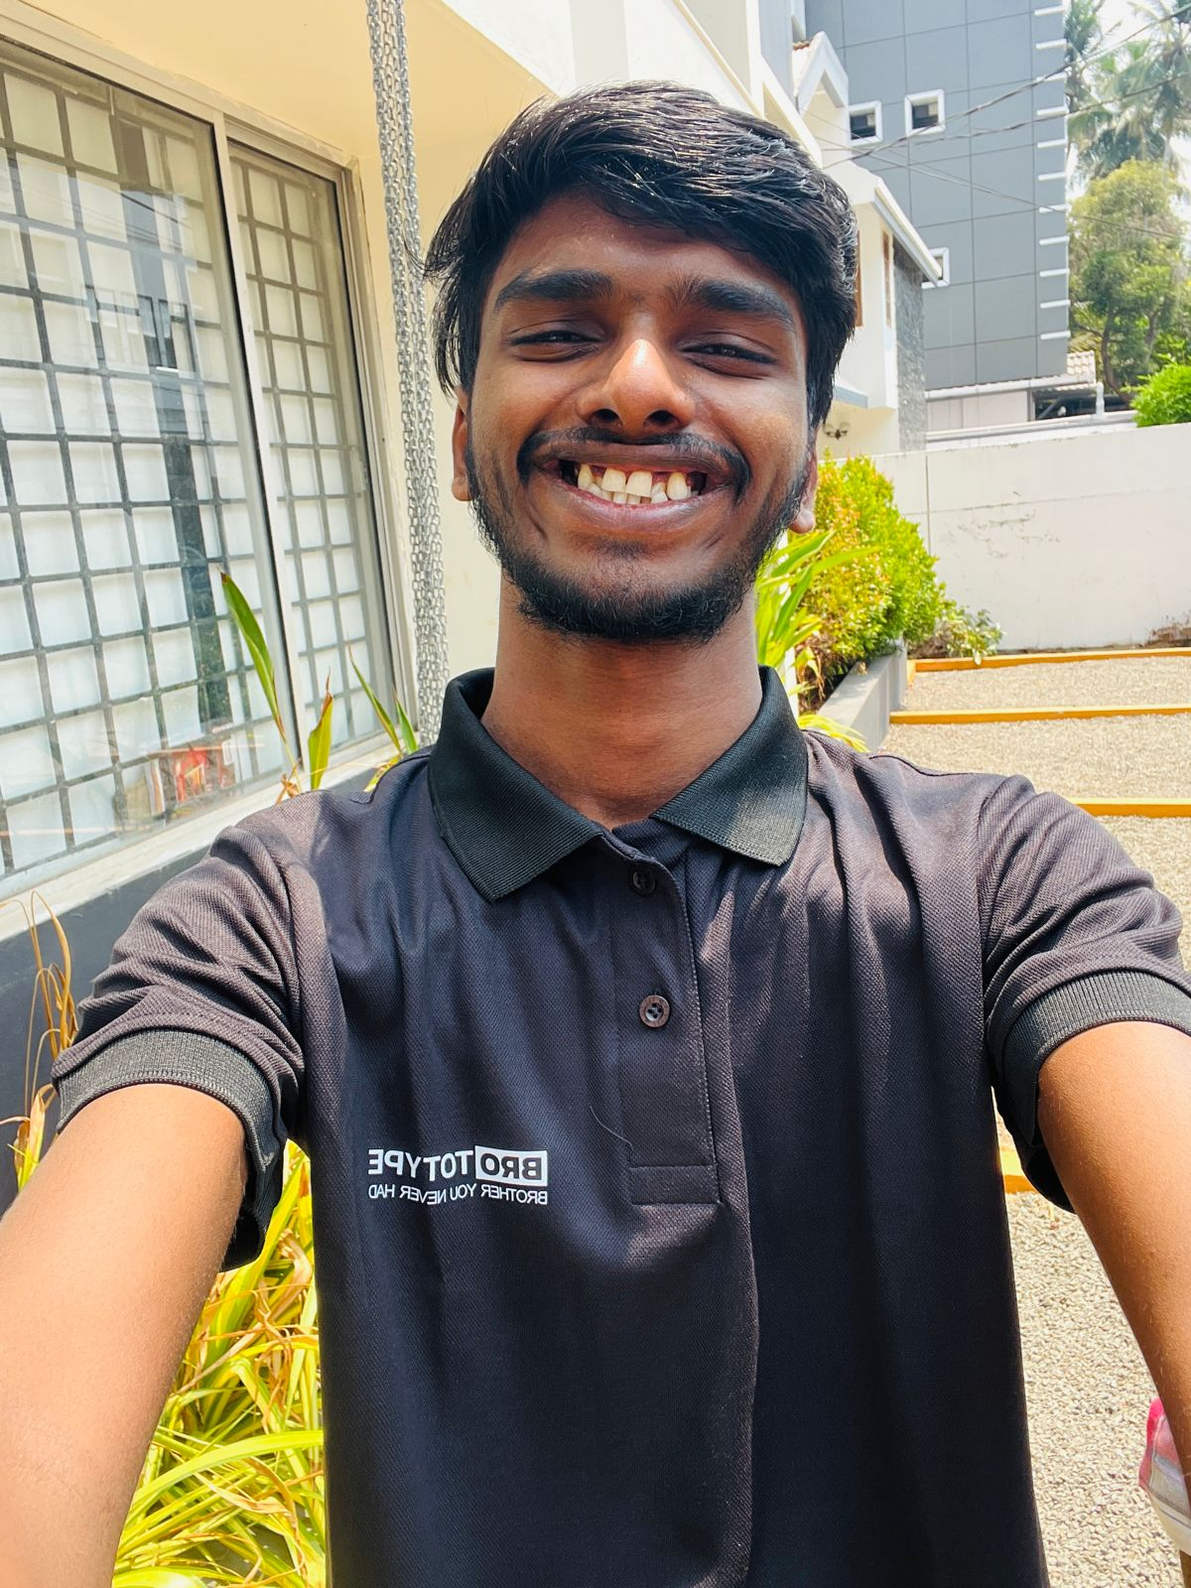
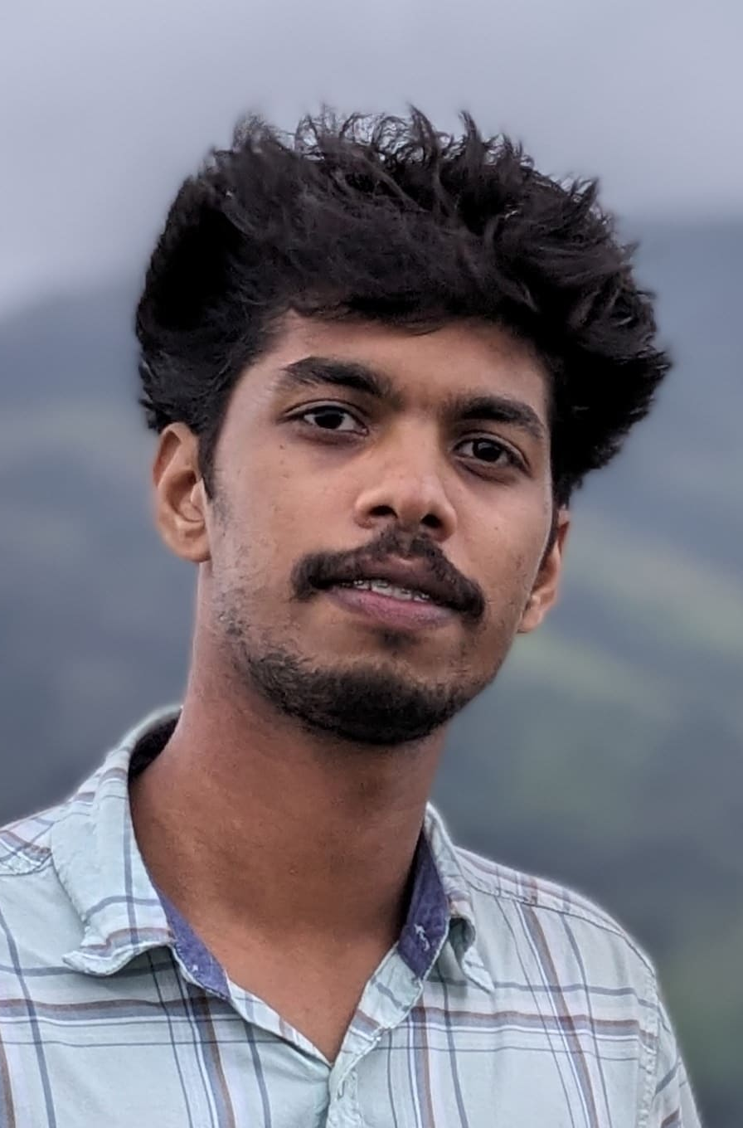
Team
03
Aiswarya
Level: Intermedate
Absentees: 10
Jishnu
Level: Beginner
Absentees: 01
Sayanth
Level: Pre-Intermediate
Absentees: 02

Slide 10

04
Activity of The Month

Slide 11
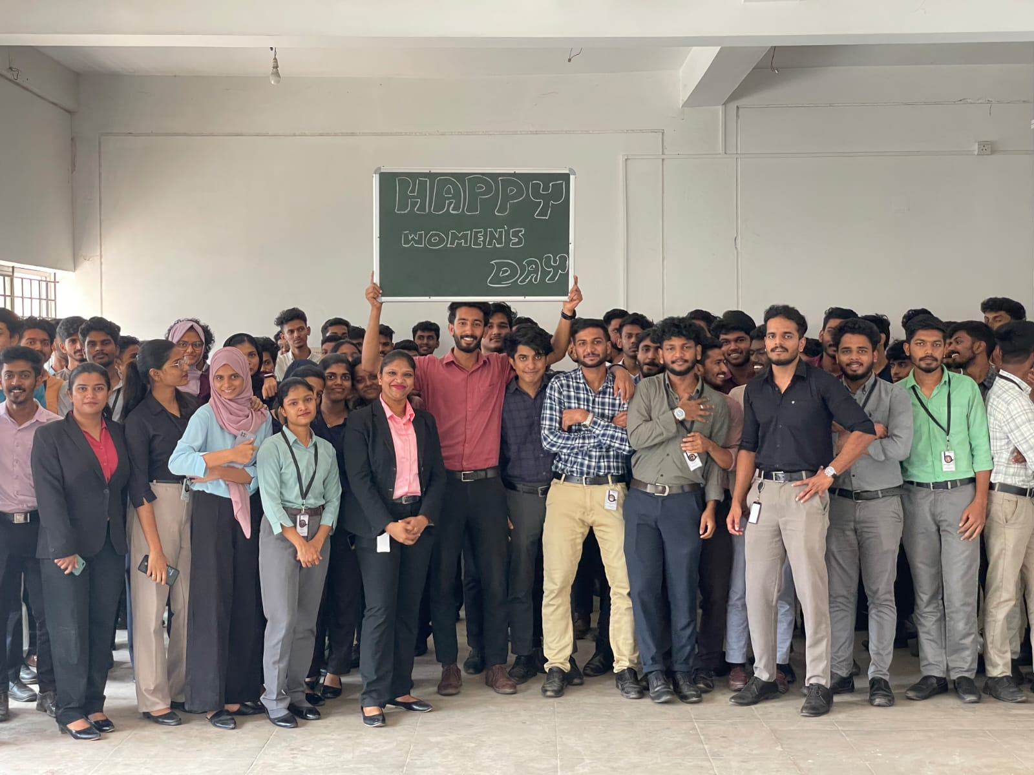
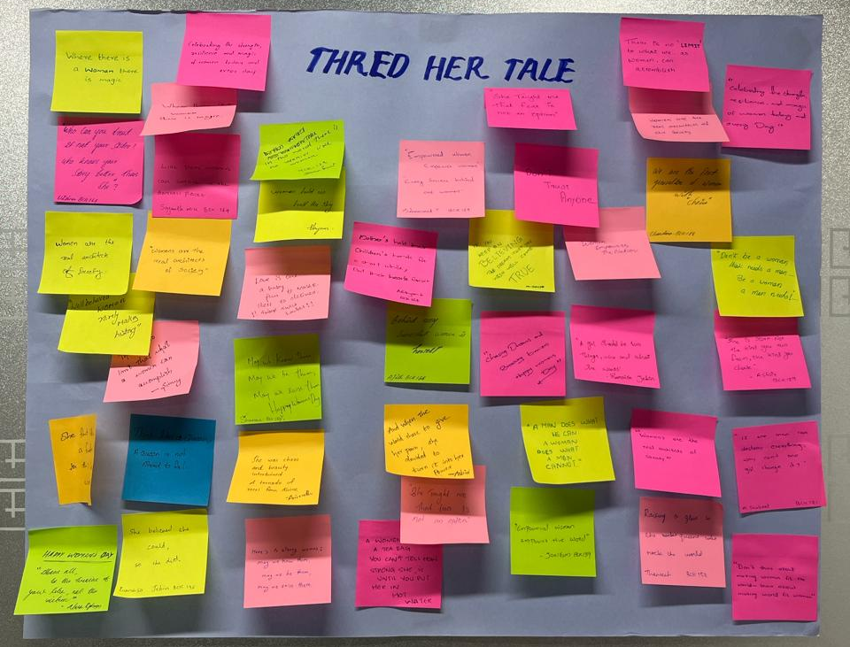
Women's day
The International Women's Day program provided a dynamic platform for celebrating empowerment and resilience. Featuring a quiz competition, saree draping workshop, and public speaking session, the event epitomized unity and advocacy for gender equality. Engaging hosting set the tone for an inclusive and inspiring atmosphere, fostering learning, connection, and empowerment among participants.

Slide 12
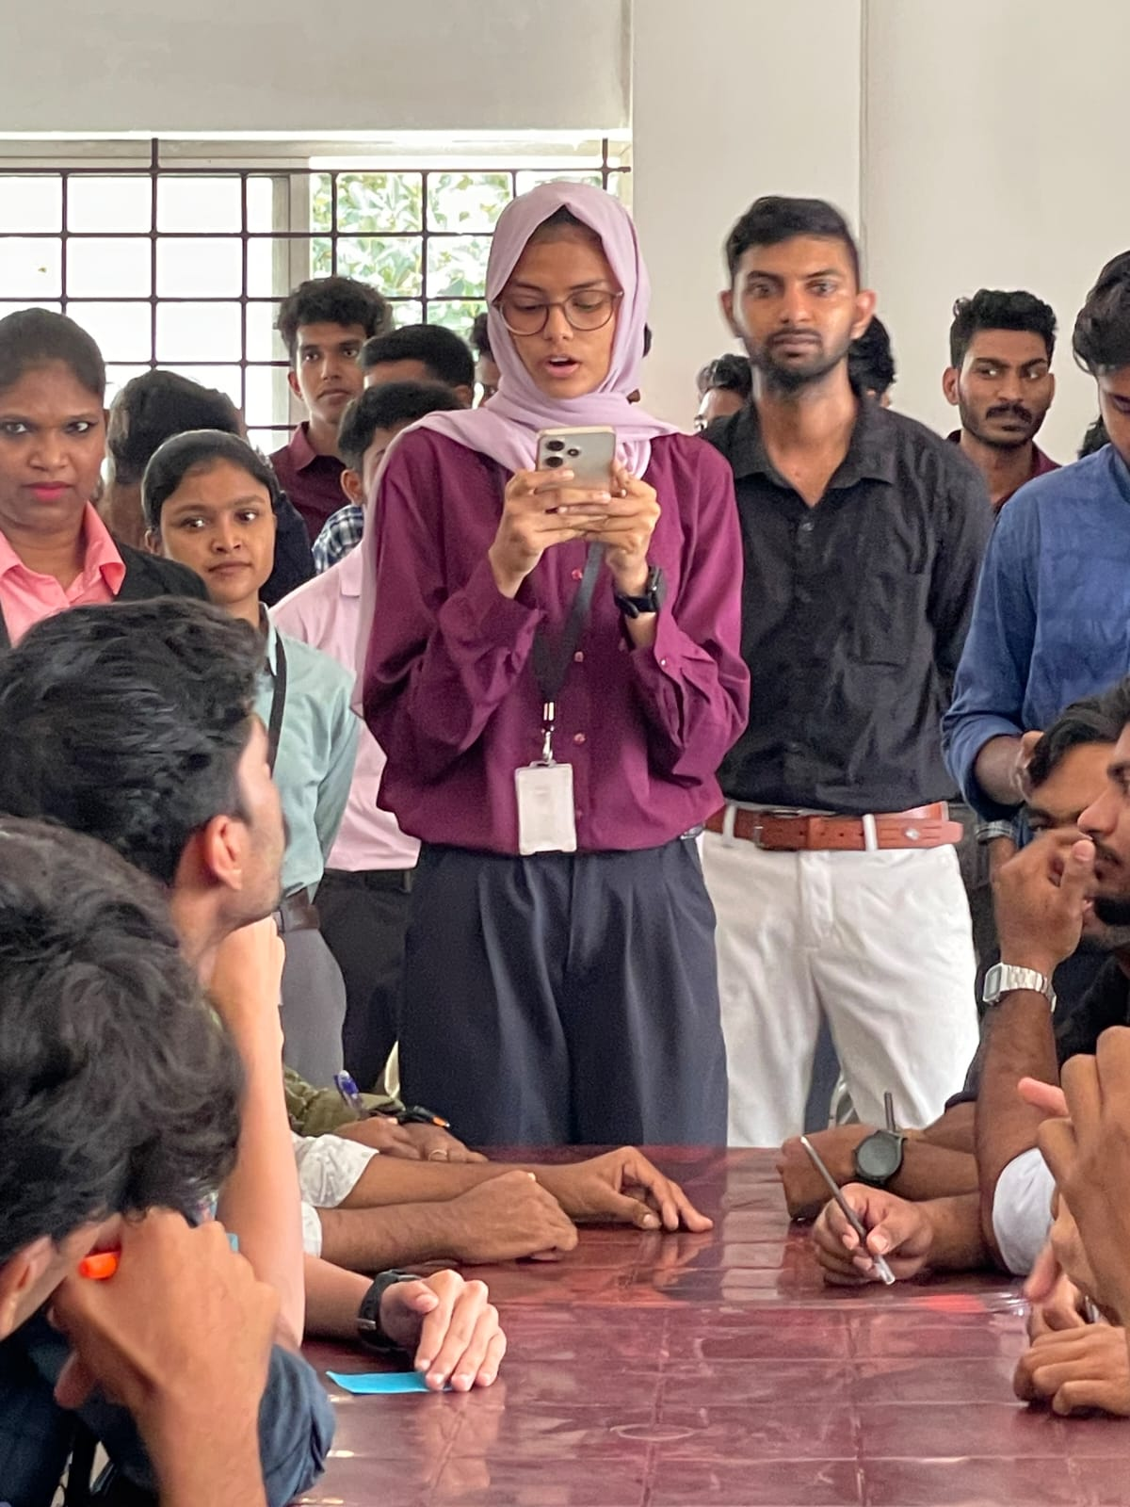
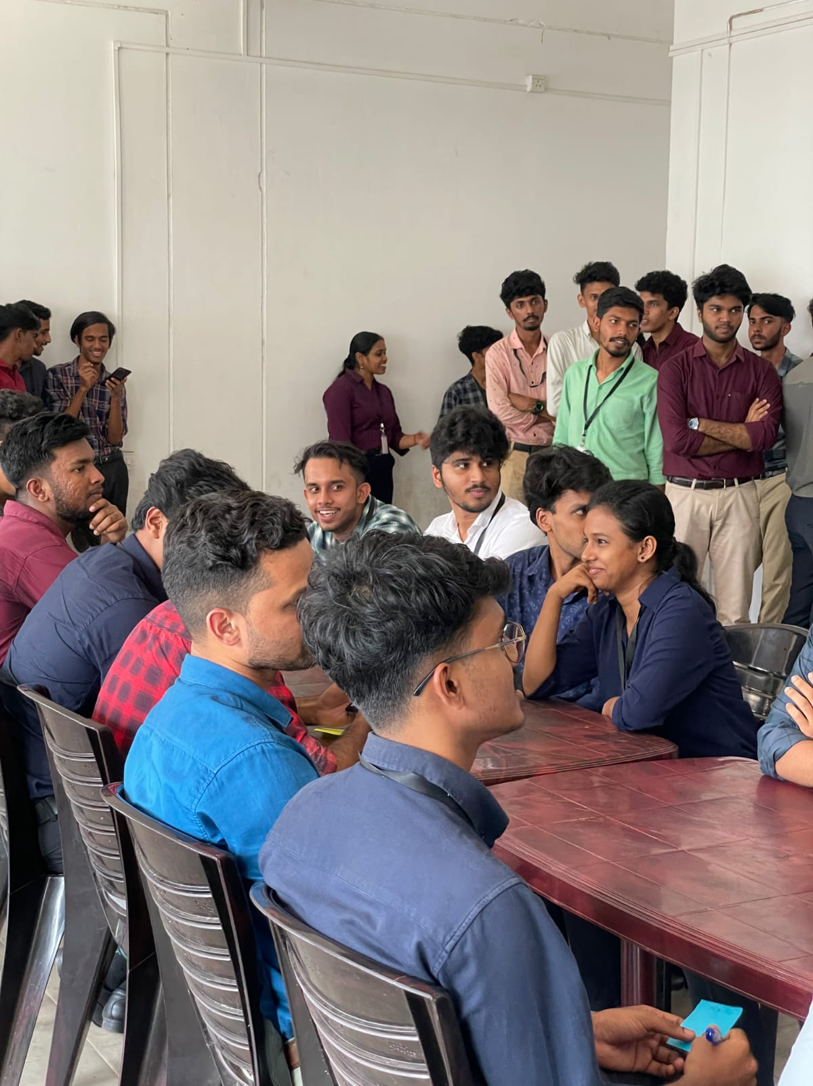
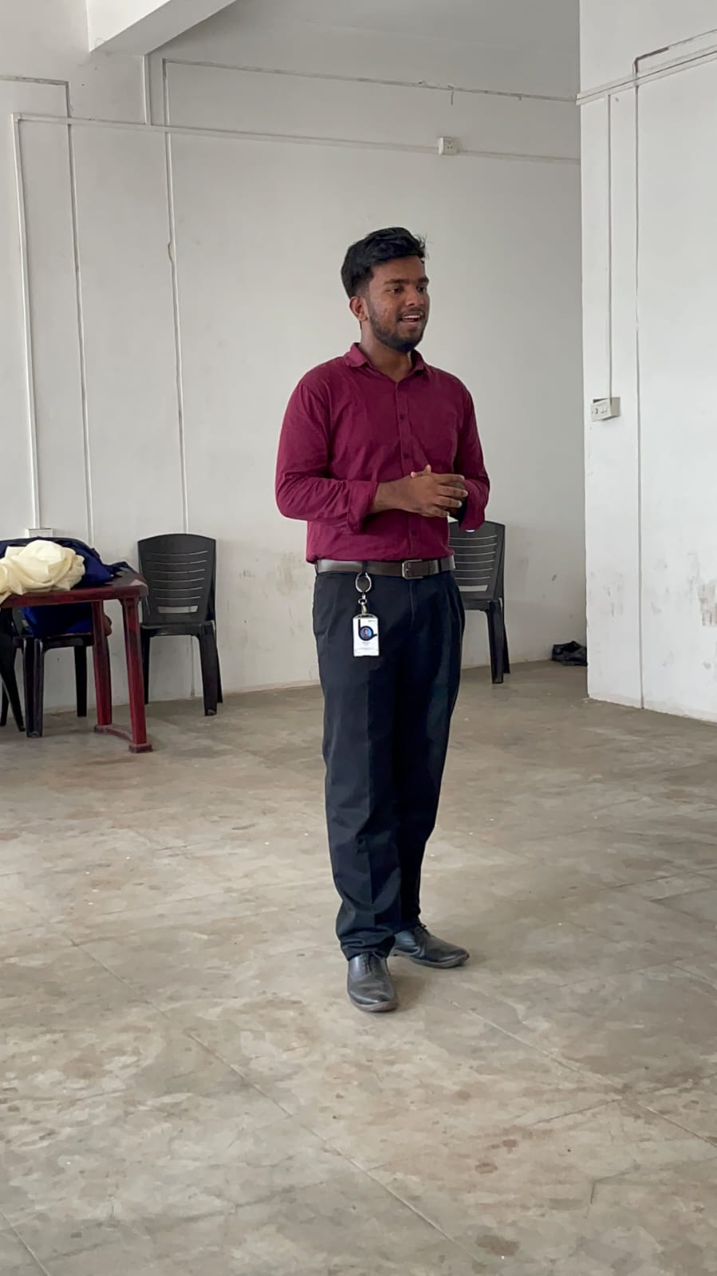
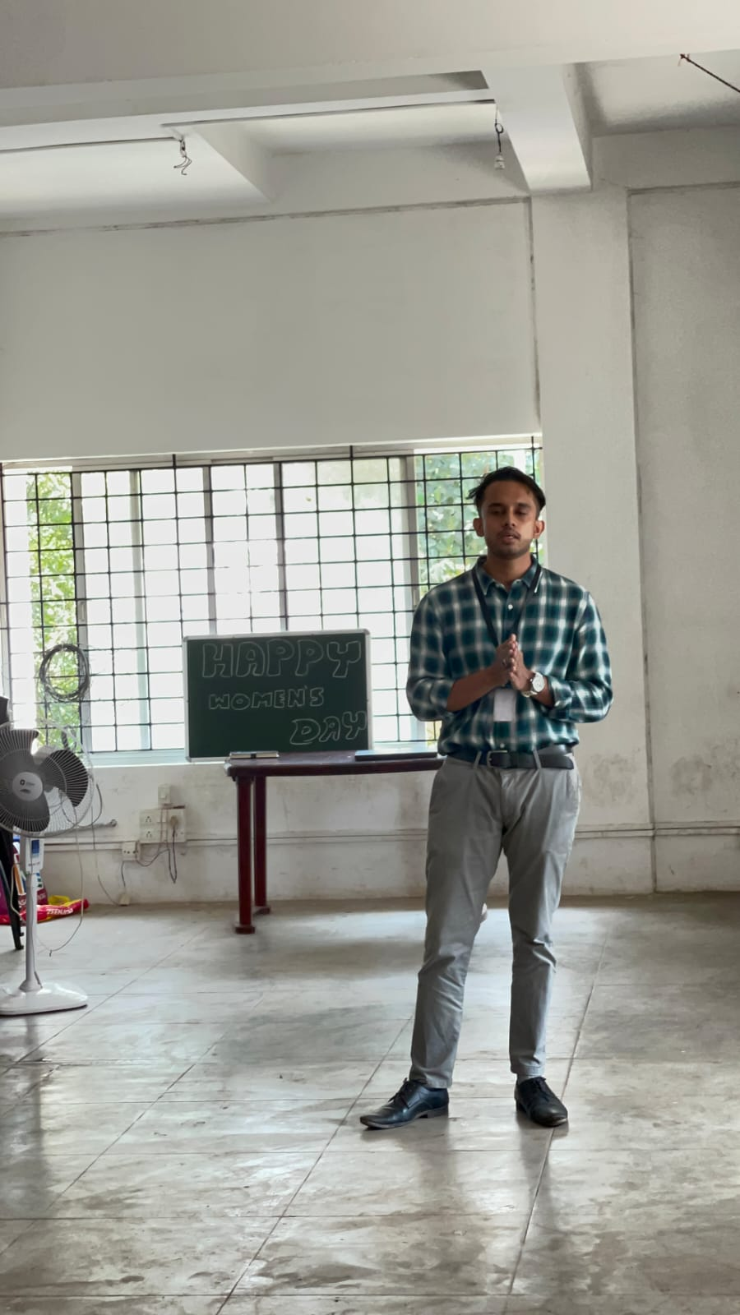
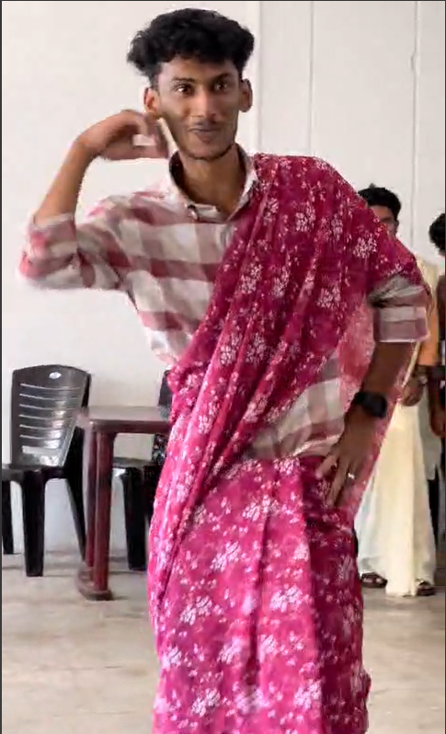
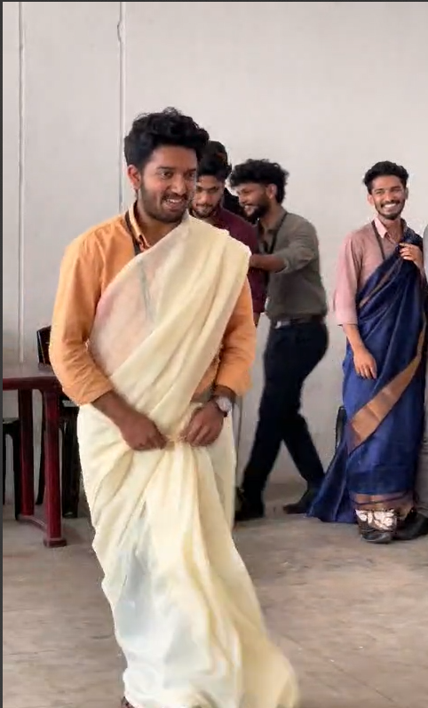
Quiz competition
Saree Draping
Public Speaking
In a delightful celebration of culture and camaraderie, our institution organized a Saree Draping Challenge game, adding a playful twist to the traditional art of saree draping. Participants, paired up with their counterparts, embarked on a thrilling challenge to drape a saree within a tight time frame of two minutes, with the enthusiastic support and cheers of the audience serving as a backdrop to the event.
The game unfolded with each pair of participants, comprising a boy and his partner, endeavoring to master the intricate art of saree draping within the allotted time. As the clock ticked away, the audience was treated to moments of hilarity and amusement, with comedic elements interspersed throughout the event, adding an extra layer of joy and entertainment to the proceedings. Laughter echoed through the venue as participants gamely attempted to conquer the saree draping challenge, often with endearing and humorous results.
In honor of International Women's Day, We hosted a thrilling Quiz Competition that brought together participants from various batches to celebrate the remarkable achievements of women.
The competition commenced with a General Knowledge round, delving into the rich tapestry of women's history, rights movements, and iconic figures. As the rounds progressed, participants navigated through a Current Affairs segment, exploring recent milestones and initiatives in women's empowerment, before facing the adrenaline-fueled challenge of a Rapid Fire round, where quick reflexes and sharp intellect were put to the test.
Amidst the spirited competition, the pair of Sayanth and Adhithyan from Batch BCK164 emerged triumphant, showcasing exceptional teamwork, depth of knowledge, and lightning-fast responses. Their victory resonated as a testament to the power of collaboration and celebration of women's achievements.
In a heartwarming celebration of Women's Day, our institution hosted a poignant public speaking event, where participants shared heartfelt tributes to the influential women in their lives. Each speaker captivated the audience with personal anecdotes, touching stories, and heartfelt reflections on the invaluable contributions of women to society and individual growth. From mothers and sisters to mentors and friends, the speakers eloquently conveyed the profound impact of these women on their lives, highlighting their resilience, compassion, and unwavering support.
As the event drew to a close, Abhinav took center stage and concluded the evening with a soul-stirring performance, dedicating a melodious song to the audience. His heartfelt rendition resonated with the spirit of celebration and appreciation, leaving a lasting impression on all who were present.

Slide 13
05
Highlight Activities

Slide 14

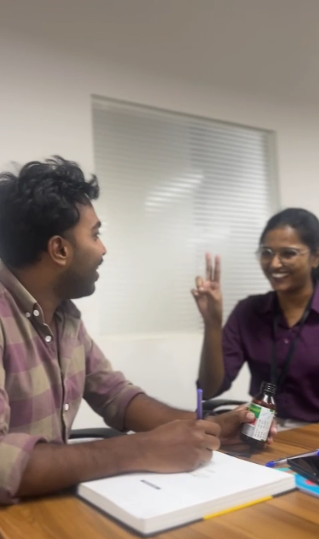
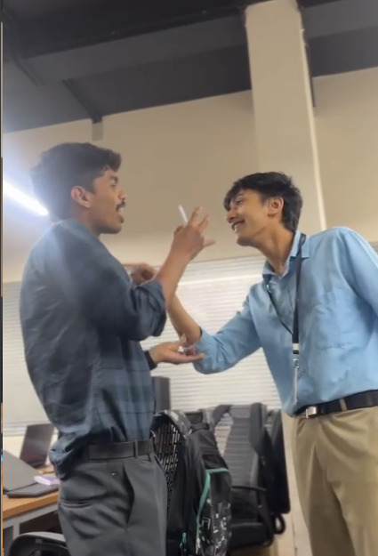
Role - Play
Introduction:
The role-play activity "Filing an FIR" provided an engaging and interactive platform for participants to immerse themselves in a simulated scenario of filing a police complaint. Each pair consisted of a participant assuming the role of a police officer and another participant portraying a member of the public filing a complaint. Through this role-play, participants not only practiced casual communication but also infused elements of comedy to make the session enjoyable and memorable.
Objective:
The primary objective of the role-play activity was to simulate a realistic scenario of filing an FIR (First Information Report) while incorporating humor to create a light-hearted atmosphere. By assuming different roles and navigating through the process of filing a police complaint, participants aimed to enhance their communication skills, adaptability, and ability to improvise in dynamic situations..
Role-Play Execution:
During the role-play session, each pair enacted a scenario wherein the member of the public approached the police officer to file a complaint. The scenarios varied in nature, encompassing a wide range of incidents such as theft, vandalism, noise complaints, and other misdemeanors. Participants infused humor into their interactions, incorporating witty dialogues and comedic elements to lighten the mood and create an enjoyable experience for all involved.
Key Highlights:
The role-play activity proved to be a highlight of the month, eliciting laughter and generating memorable moments for participants. The incorporation of comedy elements added a layer of entertainment and fostered a relaxed atmosphere conducive to open communication. Participants embraced their roles with enthusiasm, demonstrating creativity, spontaneity, and a willingness to step outside their comfort zones.
Conclusion:
The "Filing an FIR" role-play activity served as a fun and interactive platform for participants to practice casual communication, embrace creativity, and cultivate a sense of humor. By stepping into the shoes of different characters and navigating through simulated scenarios, participants not only enjoyed memorable moments but also gained valuable insights and skills applicable to real-life situations.

Slide 15


Buddy System
The buddy system implemented in our batch aims to foster continuous improvement in communication skills through structured feedback sessions. By dividing the batch into three groups based on communication proficiency levels (Intermediate, Pre-Intermediate, and Beginner), we facilitate targeted feedback and support tailored to individual needs.
Feedback Structure:
Each participant is assigned a buddy from a different proficiency level group. They are tasked with providing constructive feedback on their buddy's daily morning audio task. Feedback focuses on communication clarity, language proficiency, and presentation skills.
The buddy system serves as a valuable tool for enhancing communication skills within our batch. By providing structured feedback and fostering a culture of continuous improvement, participants can actively engage in their personal and professional development journey.
Process Overview:
Assignment of Buddies: Buddies are assigned based on their proficiency levels to ensure balanced feedback exchange.
Submission of Morning Audio Task: Participants record and submit their morning audio task, which includes speaking on a given topic or expressing their thoughts on a prompt.
Feedback Exchange: Buddies listen to each other's audio recordings and provide detailed feedback based on predefined criteria.
Feedback Review: Participants review the feedback received from their buddies and reflect on areas for improvement.
Continuous Improvement: Participants utilize feedback to enhance their communication skills, focusing on areas highlighted by their buddies.

Slide 16
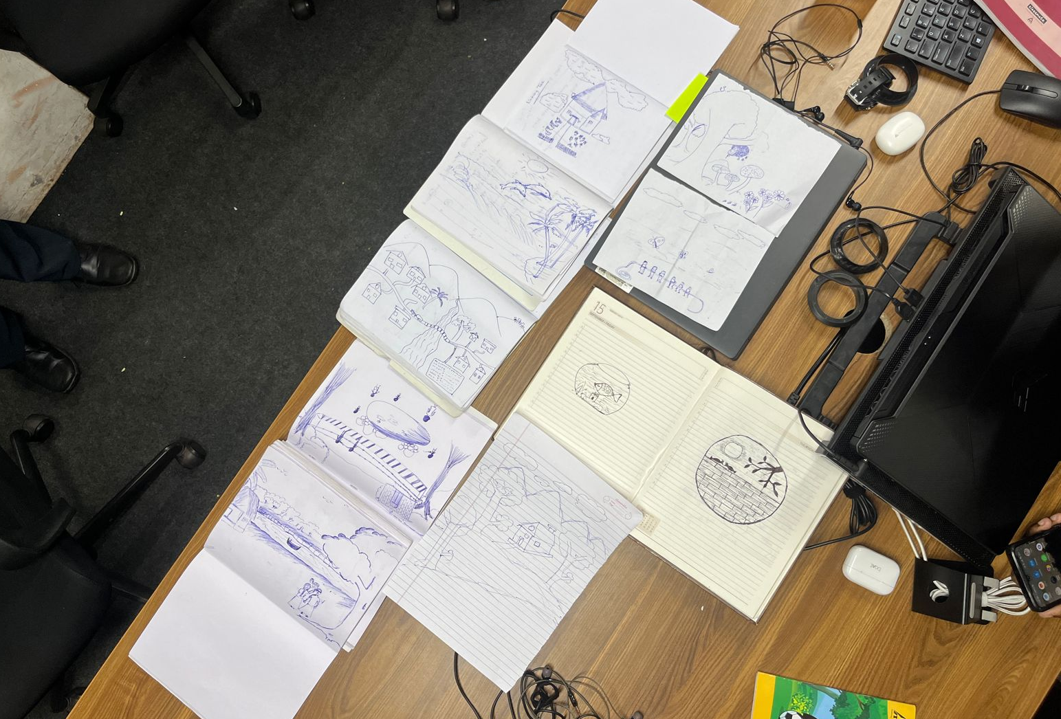
Active Listening Game
“Active listening" is a collaborative game designed to enhance active listening, imagination, and the ability to effectively communicate thoughts and ideas. Participants work in pairs to explore images sourced from the internet, with one individual tasked with describing the visual elements while the other interprets and draws based solely on verbal instructions. Through this engaging activity, participants can sharpen their listening skills, strengthen their ability to visualize concepts, and practice clear and precise communication.
Game Setup:
Pair participants into teams of two, ensuring each pair consists of one describer and one drawer.
Allocate time for each round of the game, typically 5-10 minutes per image.
Provide access to internet-enabled devices for participants to search for images.
Game Rules:
Each pair collaborates to select an image from the internet.
The describer examines the selected image privately while the drawer refrains from viewing it. Once ready, the describer begins to verbally articulate the visual elements of the image to their partner. The describer's goal is to provide clear, detailed descriptions that enable the drawer to visualize the image accurately.
The drawer listens attentively to the describer's instructions and translates the verbal descriptions into a visual representation on paper.
Rotate and repeat
Conclusion:
"Visual Interpretation" offers an engaging platform for participants to hone their active listening, imagination, and communication skills in a collaborative and interactive setting. By exploring images, describing visual elements, and translating descriptions into drawings, participants cultivate valuable competencies essential for effective interpersonal communication and creative expression.

Slide 17
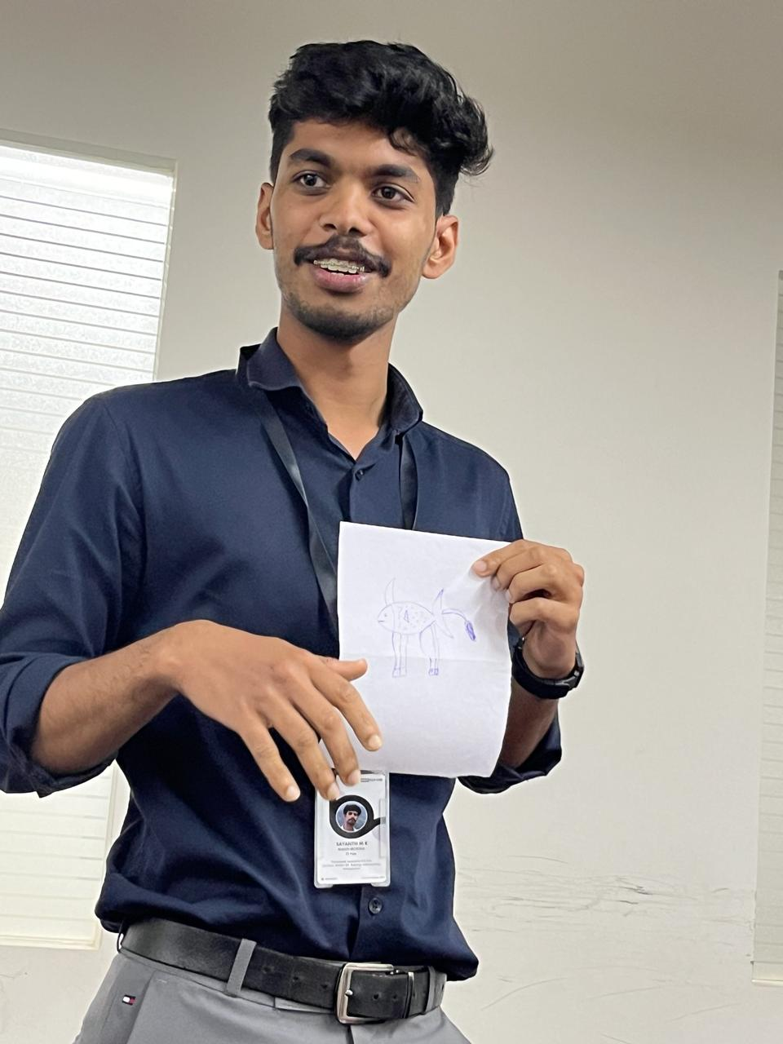
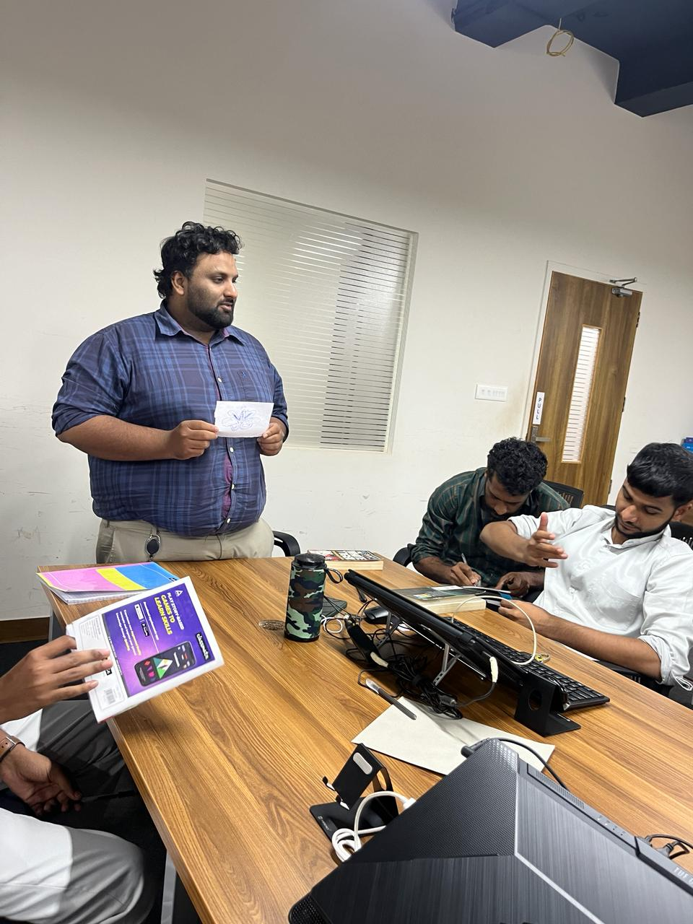
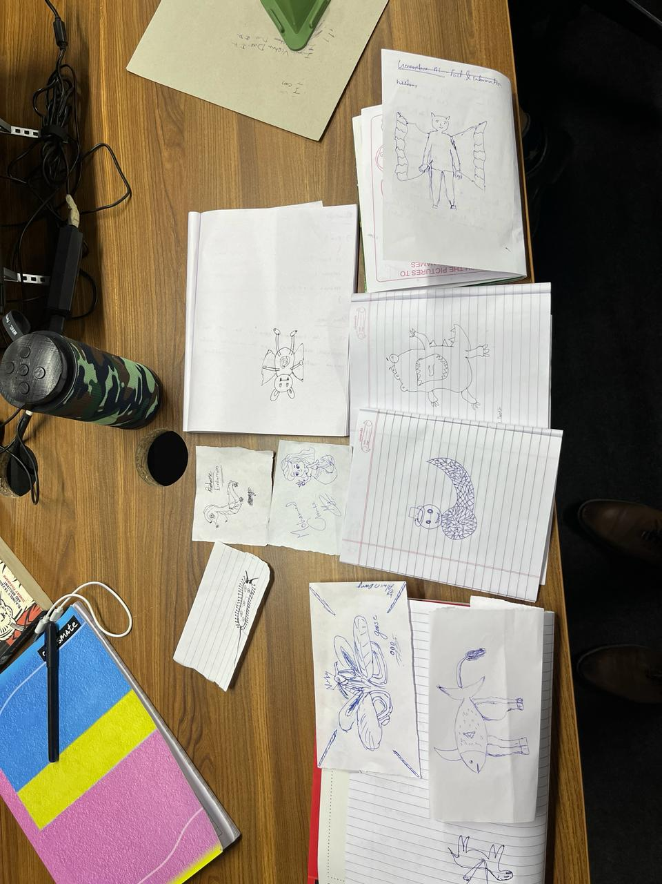
My Spiritual Animal
Introduction to Spiritual Animals: The session commenced with an introduction to the concept of spiritual animals, emphasizing their representation of individuals' personalities, aspirations, and life journeys. Participants were encouraged to explore their imagination and choose or create a spiritual animal that resonated with them.
Creative Drawing: Participants engaged in a creative drawing activity, spending 10-15 minutes sketching their chosen or imagined spiritual animals on paper. The emphasis was placed on expression rather than artistic skill, fostering a non-judgmental environment for self-expression.
Sharing and Explaining : Following the drawing session, each participant presented their spiritual animal to the group. They eloquently explained why they chose a particular animal, discussed the characteristics or attributes symbolizing themselves, and reflected on how their spiritual animal could aid in personal growth.
Group Discussion : After each presentation, a lively group discussion ensued, allowing participants to ask questions, provide positive feedback, and delve deeper into each other's interpretations and perspectives. The exchange of ideas fostered a sense of camaraderie and mutual understanding among the participants.

Slide 18
Conclusion
In summary, the monthly sessions have been instrumental in fostering a culture of growth, collaboration, and empowerment among participants. Through engaging activities and insightful discussions, attendees have explored various facets of communication, cultural appreciation, and personal development. Key highlights include the International Women's Day program, which celebrated diversity and advocacy for gender equality, and the integration of daily tasks and timeline-based activities to provide a structured approach to skill enhancement. Moving forward, these sessions will continue to serve as a catalyst for personal and professional growth, empowering participants to thrive in their communication journey and beyond

